Slide 1
Lecture 9: Name and Directory Servers
CDK4: Chapter 9
CDK5: Chapter 13
TVS: Chapter 5

Slide 2
Binding RPC Client to Server
Not desirable to hardwire the machine name and port number used by a server into a client
Use a directory server instead (to find machine) – directory server machine known
Use a local daemon on that machine to find port to use (daemon uses known port)
COMP28112 Lecture 9

Slide 3
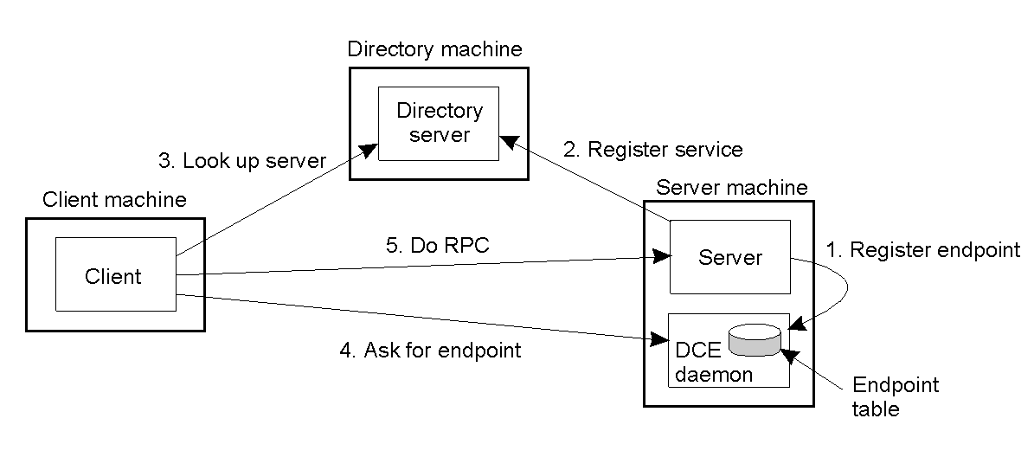
Binding a Client to a Server
TVS: Figure 4-13 Client-to-server binding in a Distributed Computing Environment (endpoint – commonly known as a port)
COMP28112 Lecture 9

Slide 4
Names
Pure names contain no information about the item they are associated with (Needham)
Other names may either tell you what sort of object they refer to, or something about where it can be found
An address is an extreme example of a non-pure name
COMP28112 Lecture 9

Slide 5
Name resolution
A name is resolved when it is translated into data about the item
Names are bound to attributes (i.e. values of properties – such as addresses!)
A name has a namespace or domain …
You can compose names to make bigger ones (e.g. URLs)
COMP28112 Lecture 9

Slide 6
Composed naming domains used to access a resource from a URL
URL
http://www.cdk4.net:8888/WebExamples/earth.html
http://www.cdk3.net:8888/WebExamples/earth.html
DNS lookup
Resource ID (IP number, port number, pathname)
55.55.55.55
8888
WebExamples/earth.html
Web server
Network address
2:60:8c:2:b0:5a
file
2:60:8c:2:b0:5a
CDK4 Fig 9.1, CDK5 Fig 13.1
COMP28112 Lecture 9

Slide 7
URIs, URLs, and URNs
Uniform Resource Identifiers identify resources on the Web. Start by identifying the URI scheme – e.g. http:, ftp:, etc.
Uniform Resource Locators – a subset of URIs which give a location for a resource
Uniform Resource Names – URIs which are not URLs, e.g. urn:ISBN:0-201-62433-8
COMP28112 Lecture 9

Slide 8
Namespaces
Can be flat (e.g. a number, a string)
Or structured (i.e. hierarchic) e.g. a Unix file name
If hierarchic, each part of the name is resolved in a different context
COMP28112 Lecture 9

Slide 9
DNS
Domain Name System – names computers across the Internet
Uses replication and caching
Strict cache consistency not vital
Very large amount of data – partitioned by domain
In general need to involve >1 name server in full name resolution
COMP28112 Lecture 9

Slide 10
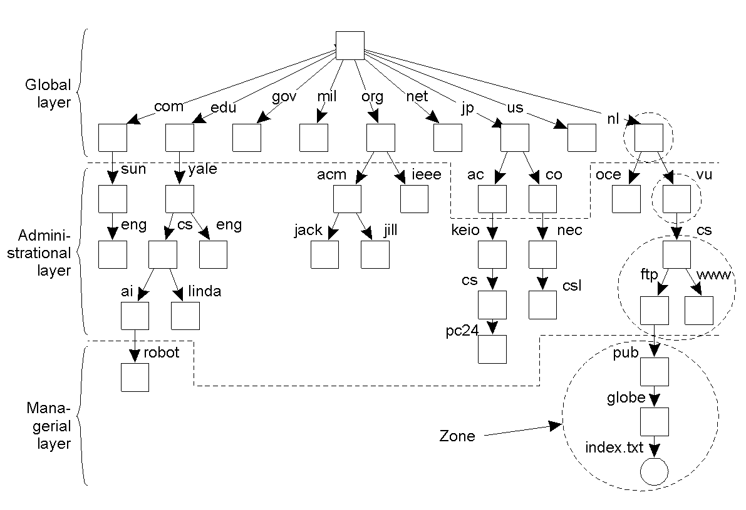
Name Space Distribution (1)
TVS: Fig. 5-13. An example partitioning of the DNS name space, including Internet-accessible files, into three layers.
COMP28112 Lecture 9

Slide 11
Name Space Distribution (2)
Item | Global | Administrational | Managerial
Geographical scale of network | Worldwide | Organization | Department
Total number of nodes | Few | Many | Vast numbers
Responsiveness to lookups | Seconds | Milliseconds | Immediate
Update propagation | Lazy | Immediate | Immediate
Number of replicas | Many | None or few | None
Is client-side caching applied? | Yes | Yes | Sometimes
TVS: Fig. 5-14. A comparison between name servers for implementing nodes from a large-scale name space partitioned into a global layer, as an administrational layer, and a managerial layer.
COMP28112 Lecture 9

Slide 12
Name Resolution
Each client has a local name resolver
It can work
  Iteratively
  Recursively
Use #<xx> to mean the address of the name server for handling names in the node <xx>
COMP28112 Lecture 9

Slide 13
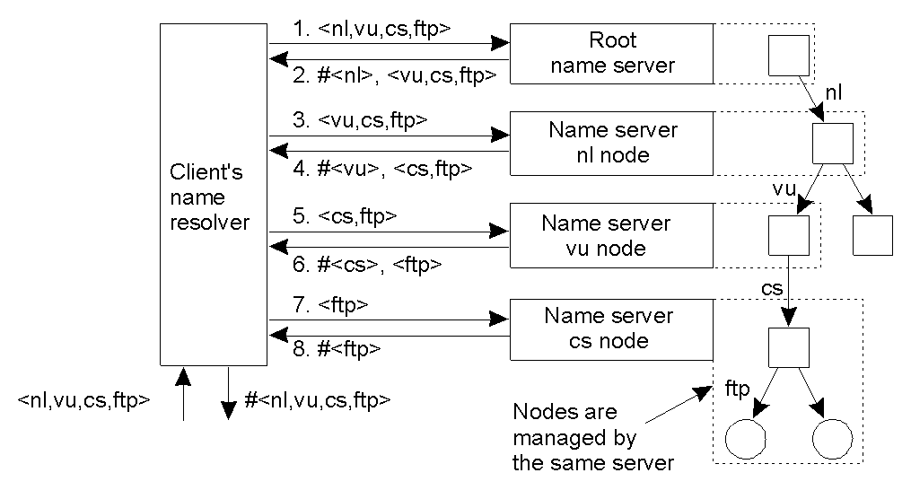
Implementation of Name Resolution (1)
TVS: Fig 5-15 Iterative Name Resolution
COMP28112 Lecture 9

Slide 14
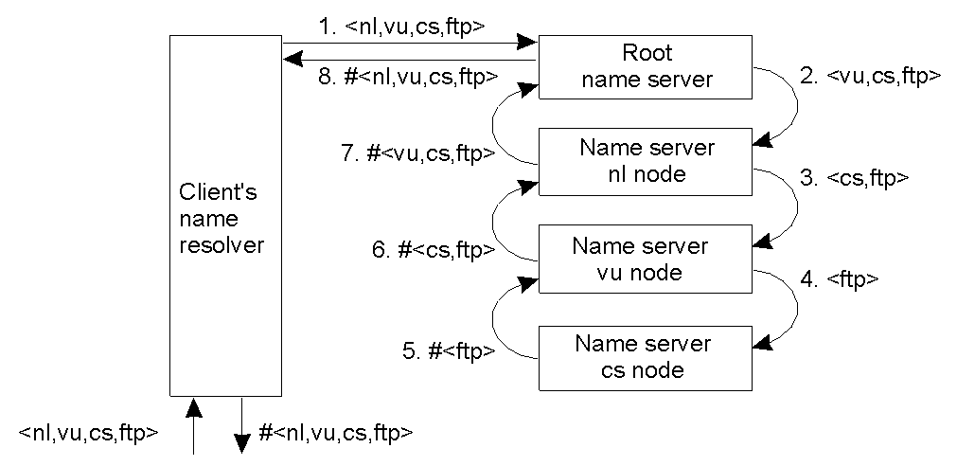
Implementation of Name Resolution (2)
TVS: Fig 5-16: recursive name resolution.
COMP28112 Lecture 9

Slide 15
Iterative vs Recursive Resolution
Recursive resolution puts more burden on a name server – global layers support only iterative resolution
Recursive resolution makes caching more effective ….
Communication costs may be lower for recursive resolution
COMP28112 Lecture 9

Slide 16
Implementation of Name Resolution (3)
Server for node | Should resolve | Looks up | Passes to child | Receives and caches | Returns to requester
cs | <ftp> | #<ftp> | -- | -- | #<ftp>
vu | <cs,ftp> | #<cs> | <ftp> | #<ftp> | #<cs> #<cs, ftp>
nl | <vu,cs,ftp> | #<vu> | <cs,ftp> | #<cs> #<cs,ftp> | #<vu> #<vu,cs> #<vu,cs,ftp>
root | <nl,vu,cs,ftp> | #<nl> | <vu,cs,ftp> | #<vu> #<vu,cs> #<vu,cs,ftp> | #<nl> #<nl,vu> #<nl,vu,cs> #<nl,vu,cs,ftp>
TVS: Fig. 5-17 Recursive name resolution of <nl, vu, cs, ftp>.
COMP28112 Lecture 9

Slide 17
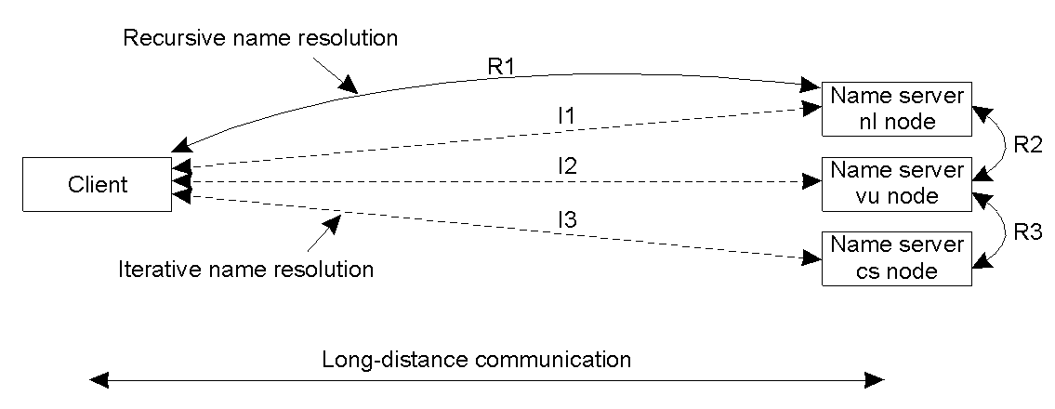
Implementation of Name Resolution (4)
TVS: Fig. 5-18. The comparison between recursive and iterative name resolution with respect to communication costs.
COMP28112 Lecture 9

Slide 18
Zones
DNS data divided into zones
Each contains attribute data for a domain, but not that held in a sub-domain
Two authoritative name servers for zone
Names of servers for sub-domains
Zone management data (e.g. lifetime of cached items ….)
COMP28112 Lecture 9

Slide 19
The DNS Name Space
Type of record | Associated entity | Description
SOA | Zone | Holds information on the represented zone
A | Host | Contains an IP address of the host this node represents
MX | Domain | Refers to a mail server to handle mail addressed to this node
SRV | Domain | Refers to a server handling a specific service
NS | Zone | Refers to a name server that implements the represented zone
PTR | Node | Symbolic link with the primary name of the represented node
CNAME | Host | Contains the canonical name of a host
HINFO | Host | Holds information on the host this node represents
TXT | Any kind | Contains any entity-specific information considered useful
TVS: Fig. 5-19 .The most important types of resource records forming the contents of nodes in the DNS name space.
COMP28112 Lecture 9

Slide 20
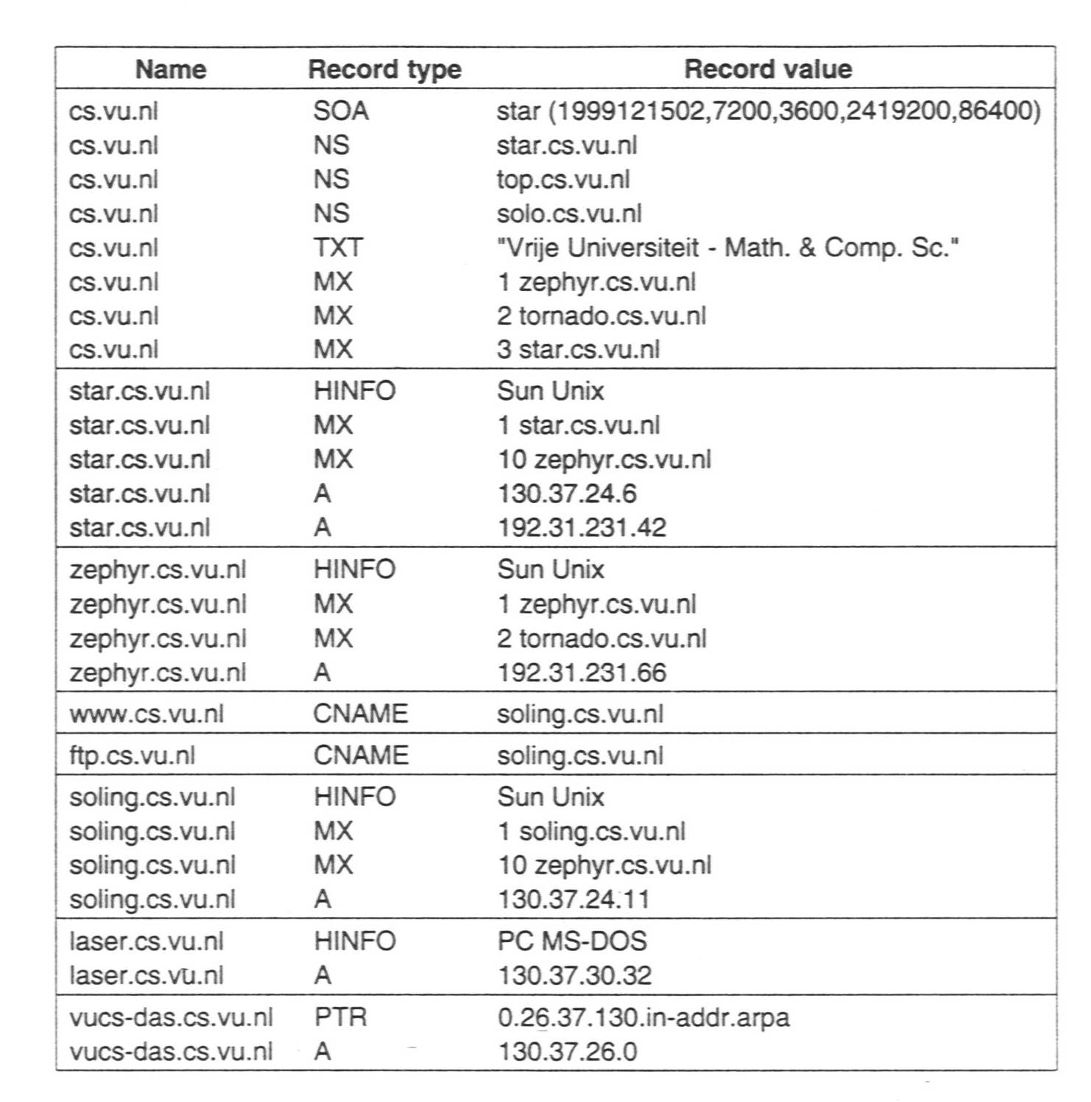
DNS Implementation
TVS: Figure 5-20. An excerpt from the DNS database for the zone cs.vu.nl.
COMP28112 Lecture 9

Slide 21
Name Server vs Directory Server
A name server takes a name, and returns one or more attributes of the named object
A directory server takes attribute values, and returns sets of attributes of objects with those attribute values
Like telephone directory: white pages vs yellow pages distinction
COMP28112 Lecture 9

Slide 22
X.500 Directory Service
X.500 invented by standards organisations
Collection of all entries = Directory Information Base (DIB) – portions on different servers (Directory Service Agents, DSAs).
Clients are Directory User Agents (DUAs)
Get a Directory Information Tree (DIT)
COMP28112 Lecture 9

Slide 23
LDAP
Lightweight Directory Access Protocol - a simple protocol for use with X.500
Allows more simple directory lookup than X.500 for directory servers which implement
Widely adopted (e.g. Microsoft’s Active Directory Service provides an LDAP interface)
COMP28112 Lecture 9

Slide 24
Attribute | Abbr. | Value
Country | C | NL
Locality | L | Amsterdam
Organization | O | Vrije Universiteit
OrganizationalUnit | OU | Comp. Sc.
CommonName | CN | Main server
Mail_Servers | -- | 130.37.24.6, 192.31.231.42,192.31.231.66
FTP_Server | -- | 130.37.21.11
WWW_Server | -- | 130.37.21.11
TVS: Fig. 5-22. A simple example of an LDAP directory entry using LDAP naming conventions.
COMP28112 Lecture 9

Slide 25
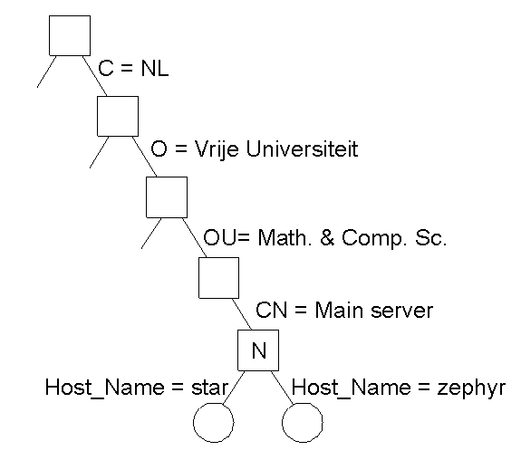
TVS: Fig. 5-23a Part of the directory information tree.
COMP28112 Lecture 9

Slide 26
TVS: Fig. 5-23b. Two directory Entries
Attribute | Value |  | Attribute | Value
Country | NL |  | Country | NL
Locality | Amsterdam |  | Locality | Amsterdam
Organization | Vrije Universiteit |  | Organization | Vrije Universiteit
OrganizationalUnit | Math. & Comp. Sc. |  | OrganizationalUnit | Math. & Comp. Sc.
CommonName | Main server |  | CommonName | Main server
Host_Name | star |  | Host_Name | zephyr
Host_Address | 192.31.231.42 |  | Host_Address | 192.31.231.66
COMP28112 Lecture 9

Slide 27
LDAP access
Entries can be read – enough info has to be provided to navigate the Directory Information Tree (DIT), but other attributes can then be obtained
Can search, starting from a node in the DIT and using a boolean filter expression to identify targets. This can be quite costly!
Next Lecture: Time and Logical Clocks
COMP28112 Lecture 9

